Slide 1

Attack Types
Ali MENTEŞ
Platon Bilişim Akademi
1
Notes:
1

Slide 2
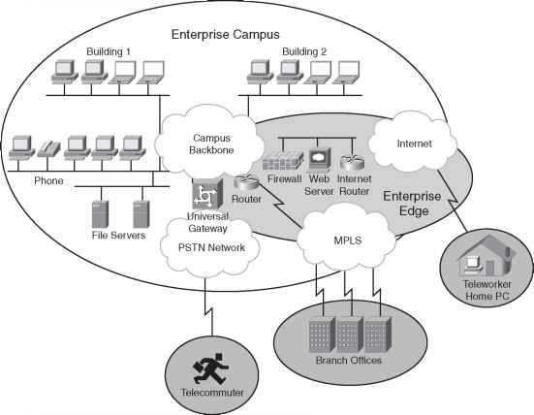
Enterprise Network
Today's enterprise network is not closed one. Remote workers,
Branches,Guests,Bussines Partners,mobile users etc.. are in connection.
That's why security is an important concept.
Notes:
3

Slide 3
Security Terms
Vulnerability(Weakness)
Interms of security, a vulnerability is anything that can be considered to be a weakness that can compromise the security of something else, such as the integrity of data or how a system performs. Door of the house is a vulnerability.
To Exploit Vulnerability
Any tool that can be used for the vulnerabilities are called Exploits.
For example any tool other then a Key that is used to open the door is an Exploit.
Threat
If there is a possibility that a user can use an exploit for the vulnerability /weakness then this is called Threat.
In the IT world of networks, systems, workstations, and applications, there are many, many different vulnerabilities and exploits that can be leveraged by malicious users to become threats to an organization and its data.
Mitigation Techniques are used for these threats.
Notes:
3

Slide 4
Human Security Vulnerabilities
Social Engineering
Exploits human trust and social behavior
Phishing
Disguises a malicious invitation as something legitimate
Spear phishing
Targets group of similar users
Whaling
Targets high-profile individuals
Vishing
Uses voice calls
Smishing
Uses SMS text messages
Pharming
Uses legitimate services to send users to a compromised site
Watering hole
Targets specific victims who visit a compromised site
Notes:
3

Slide 5
Malware
Malware SW,Viruses,Worms etc…
Characteristic Trojan Horse Virus Worm
Packaged inside other SW Yes No No
Self-injected into other SW No Yes No
Propagates automatically No No Yes
Password Valunerability!!
Notes:
3

Slide 6
AAA
Authentication: Who is the user?
Authorization: What is the user allowed to do?
Accounting: What did the user do?
There are Servers that check AAA for a user.
AAA Servers use two main protocols.
TACACS+: A Cisco proprietary protocol that separates each of the AAA functions. Communication is secure and encrypted over TCP port 49.
RADIUS: A standards-based protocol that combines authentication and authorization into a single resource. Communication uses UDP ports 1812 and 1813 (accounting)
but is not completely encrypted.
Notes:
3

Slide 7
Denail Of Service(DoS) Attack
Denying the service availablity by overloading the the Server work . It ussualy realized by creating un real service requests to the Server. This is called a denial-of-service (DoS) attack because it denies service to legitimate users or operations.
TCP DoS Attack.
TCP connection begins with the malicious user sending a SYN flag to the server, but the source IP address is replaced with a fake address. The server adds the TCP
connection to its table of client connections and replies to the fake address with a SYN-ACK. Because the fake address is not involved in the TCP connection, there is no ACK reply to complete the TCP three-way handshake.
The incomplete connection stays in the server’s table until it eventually times out and is removed. During this time, the attacker can try to open many, many more
abnormal connections at such a rate that the server’s connection table fills. At that point, the server is no longer able to maintain TCP connections with legitimate
users, so their business transactions all halt.
Notes:
3

Slide 8
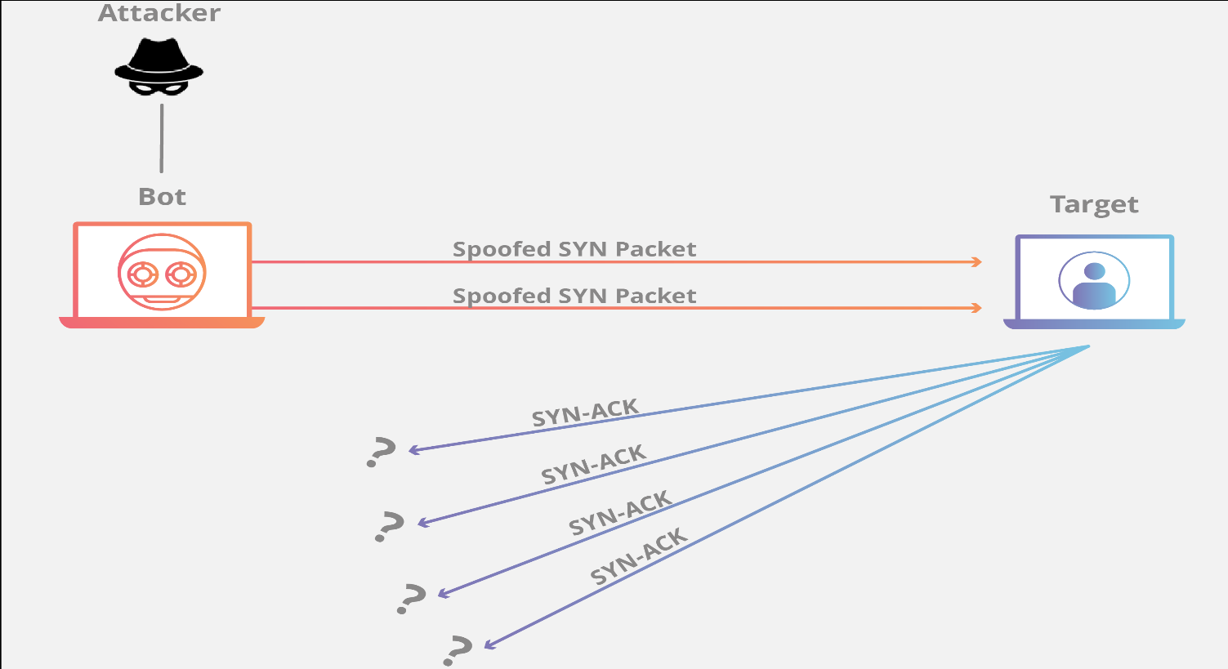
Denail Of Service(DoS) Attack
Attacker send SYN packet with spoofed source IP which is another host's IP.
So there will be SYN-ACK packets to another IP and no reponse will get.
Notes:
3

Slide 9
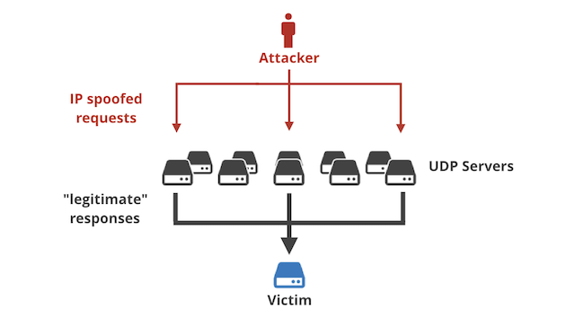
Reflection Attack(Amplified)
The attacker sends packets with a spoofed source address toward a live host. However, the host is not the intended target; the goal is to get the host to reflect the exchange toward the spoofed address that is the target. Many UDP servers (i.e NTP) send huge response packets to victim machine and its BW exeeds the rate finnaly causing the DoS. Atatcker hide itself behined the UDP servers and UDP traffic can not be controlled as TCP.
IP Packet
Source Adrs: A
Destination Adrs: B
Adres:C
Servers send Packet to dest adres
which is B
Live Host
Adrs: B
Notes:
3

Slide 10
Man-In-The-Middle Attack
Sometimes an attacker might want to eavesdrop on data that passes from one machine to another, avoiding detection. A man-in-the-middle attack does just that, by allowing the attacker to stay between the communication path as an intermediary between two target systems.
A good example for this attack is ARP Table poisining attack.
A non-legitimate user answers the ARP request(asking MAC address of an IP address) with it's MAC address.
Legitimate user populate its MAC table with wrong IP-MAC record.
Then any packet send to that IP goes to attacker's host and message is red and passed to its legitimate destination host.
This way non-legitimate user is in the middle.
Notes:
3

Slide 11
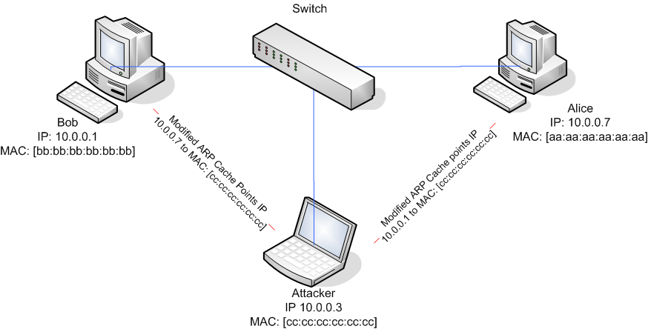
Man-In-The-Middle Attack
Notes:
3

Slide 12
Reconnaissance Attacks(Keşif Atağı)
A reconnaissance attack can be used to discover more details about the target and its systems prior to an actual attack.
During a reconnaissance attack, the attacker can use some common tools to uncover public details like who owns a domain and what IP address ranges are used there. For example, the nslookup command exists in many operating systems and can perform a DNS lookup to resolve an IP address from a fully qualified domain name. If an attacker knows the domain name of a business, nslookup can reveal the owner of the domain and the IP address space registered to it. The whois and dig commands are complementary tools that can query
DNS information to reveal detailed information about domain owners, contact information, mail servers, authoritative name servers, and so on.
C:\Users>nslookup www.cu.edu.tr
Server: dns.google
Address: 8.8.8.8
Non-authoritative answer:
Name: www.cu.edu.tr
Address: 193.140.54.16
Notes:
3

Slide 13
Reconnaissance Attacks(Keşif Atağı)
https://whois.domaintools.com/
From such a side we can get all info about an IP or web site.
After finding IP address;
Then the attacker can progress to using ping scan to send pings to each IP address in the target range. Hosts that answer the ping sweep(scan) then become live targets. Port scanning tools can then sweep through a range of UDP and TCP ports to see if a target host answers on any port numbers. Any replies indicate that a corresponding service is running on the target host. Keep in mind that a reconnaissance attack is not a true attack because nothing is exploited as a result. It is used for gathering information about target systems and services so that vulnerabilities can be discovered and exploited using other types of attacks.
Notes:
3

Slide 14
Buffer Overflow Attacks
Some systems and applications have vulnerabilities that can allow buffers to overflow. This means some incoming data might be stored in unexpected memory locations if a buffer is allowed to fill beyond its limit.
An attacker can exploit this condition by sending data that is larger than expected. If a vulnerability exists, the target system might store that data, overflowing its buffer into another area of memory, eventually crashing a service or the entire system.
The attacker might also be able to specially craft the large message by inserting malicious code in it. If the target system stores that data as a result of a buffer overflow, then it can potentially run the malicious code without realizing.
Notes:
3

Slide 15
DHCP Spoofing Attacks
Spoofing :Aldatma Kandırma
Snooping: Gizlice gözetleme,hafiyelik
Spoofing attacks focus on one vulnerability; addresses and services tend to be implicitly trusted. Attacks
usually take place by replacing expected values with
spoofed or fake values. Address spoofing attacks can be
simple and straightforward, where one address value is
substituted for another.
DHCP process is broadcast.
Rouge DHCP answers the DHCP requests and shows itself as
Gateway and plays Man In The Middle role.
DHCP Snooping prevents these attacks.
Snooping configured on SWs.
SW's ports configured as trusted or untrusted port.
If a port untrusted DHCP answers are not axcepted on these Ports.
Only trusted ports can send DHCP response.
Notes:
3

Slide 16
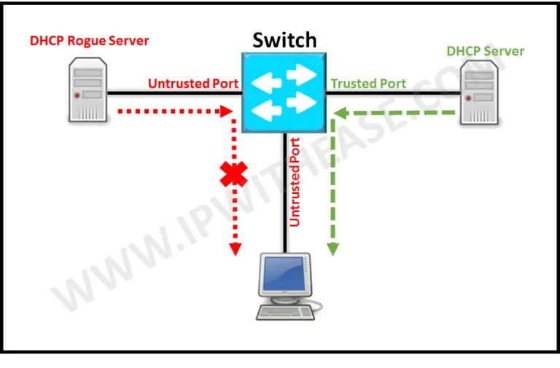
DHCP Spoofing
Notes:
3

Slide 17
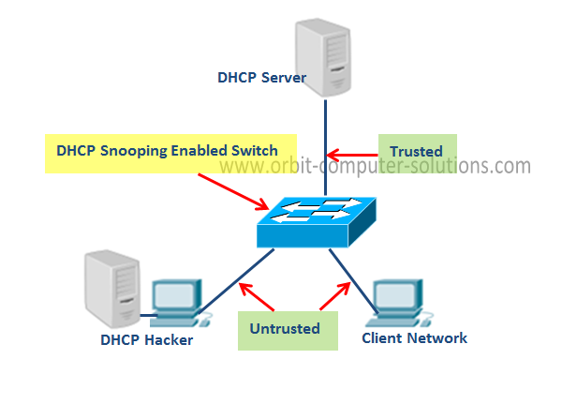
DHCP Spoofing
Snooping should enabeled on the SW.
Use 2960 SWs!!
(conf)# ip dhcp snooping enable for all vlans
(conf)# ip dhcp snooping vlan <no> enable for a vlan
On the interface
-ip dhcp snooping trust
Show ip dhcp snooping/binding/datab..
On SW relay agent is enabled(port 82)
Thats why on router we need:
ip dhcp relay information trust-all
Or disable relagy agent option(82) on SW.
no ip dhcp snooping information option
Notes:
3

Slide 18
DHCP Spoofing
DHCP DoS Attacks
Fake clients consume many IP from DHCP and then legacy clients can not.
We can configure SWs access ports to limit the DHCP Discover Messages.
If this limit exceeded interface falls down to err-disable state.
if)# ip dhcp snooping limit rate <rate>
Notes:
3

